Slide 1

ENSE 400 CAPSTONE PROJECT
Master Calculator, VLOG #2.
Oct 15, 2021

Slide 2
Content
Team member & project Re-introduction
Brief Project Blurb
Project Activities
Activity1
Activity 2
Activity 3
Status Description
Project changes
Project issues
Next up
Team Reflection
Conclusion
References
University of Regina Capstone Project@2021

Slide 3
Team member & Project Re-introduction
University of Regina Capstone Project@2021

Slide 4
Brief Project Blurb
University of Regina Capstone Project@2021

Slide 5
Project Activity
University of Regina Capstone Project@2021

Slide 6
Project Activity
University of Regina Capstone Project@2021

Slide 7
Project Activity
University of Regina Capstone Project@2021

Slide 8
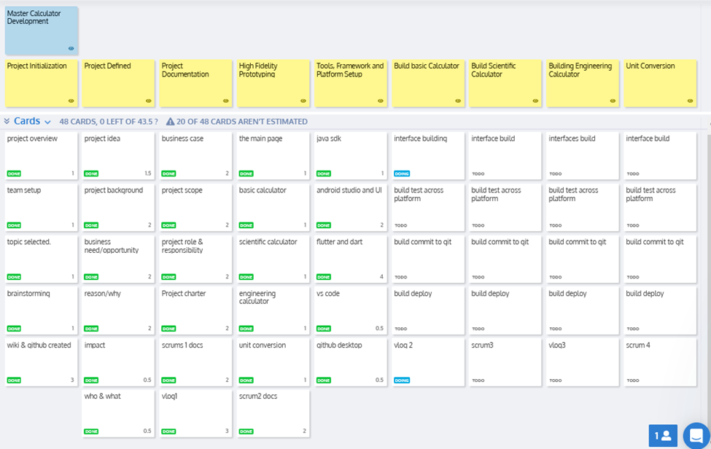
Project Activity
University of Regina Capstone Project@2021

Slide 9
Status description
University of Regina Capstone Project@2021

Slide 10
Project changes
University of Regina Capstone Project@2021

Slide 11
Project issues
University of Regina Capstone Project@2021

Slide 12
Next up
University of Regina Capstone Project@2021

Slide 13
Team Reflection
University of Regina Capstone Project@2021

Slide 14
Conclusion
University of Regina Capstone Project@2021

Slide 15
References
University of Regina Capstone Project@2021

